Slide 1
What is data analysis
Data Analysis is the process of systematically applying statistical and/or logical techniques to describe and illustrate, condense and recap, and evaluate data.
The purpose of Data Analysis is to extract useful information from data and taking the decision based upon the data analysis.
Example : - Data analysis is whenever we take any decision in our day-to-day life is by thinking about what happened last time or what will happen by choosing that particular decision.
Notes:
SUBMITTED BY : - PRAKASH MOHAN TARAI

Slide 2
What are the tools useful for data analysis.
Data analysis tools are software and programs that collect and analyze data about a business, its customers, and its competition in order to improve processes and help uncover insights to make data-driven decisions.
There are many tools such as : -
Microsoft Power BI
SAP Business Objects
Sisense
TIBCO Spotfire
Thoughtspot
Qlik
SAS Business Intelligence
Tableau
Google Data Studio
Notes:
SUBMITTED BY : - PRAKASH MOHAN TARAI

Slide 3
Redash
Periscope Data
Metabase
Jupyter Notebook
IBM Cognos
Chartio
Mode
KNIME
Looker
RapidMiner
Domo
Oracle Analytics Cloud
R
Python
Excel
Notes:
SUBMITTED BY : - PRAKASH MOHAN TARAI

Slide 4
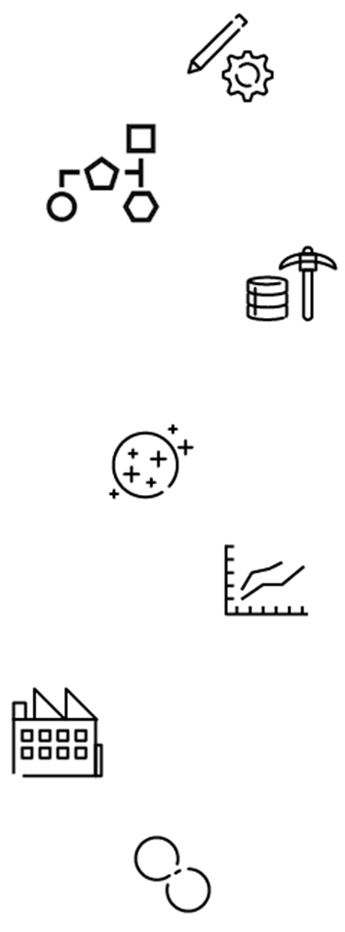
What are the various steps involved in any analytics project.
Step 1: Understand the Business
Step 2: Get Your Data
Step 3: Explore and Clean Your Data
Step 4: Enrich Your Dataset
Step 5: Build Helpful Visualizations
Step 6: Get Predictive
Step 7: Iterate, Iterate, Iterate
Notes:
SUBMITTED BY : - PRAKASH MOHAN TARAI

Slide 5
What are the responsibilities of a Data Analyst.
A data analyst oversees organizing data related to sales figures, market research, logistics, linguistics, or other behaviours.
They use technical expertise to ensure that data is accurate and of high quality.
The responsibilities of a Data Analyst are : -
Gather
Analyze
interpret vast amounts of data while working with a variety of computer science
Mathematics
Statistics-related concepts
Notes:
SUBMITTED BY : - PRAKASH MOHAN TARAI

Slide 6
Write some key skills usually required for a data analyst.
The ability to analyse, model and interpret data. Problem-solving skills.
A methodical and logical approach.
The ability to plan work and meet deadlines.
The important key skills are : -
Step One: -Ask The Right Questions. So you're ready to get started.
Step Two: - Data Collection. This brings us to the next step: data collection.
Step Three: - Data Cleaning. You've collected and combined data from multiple sources.
Step Four: - Analyzing The Data.
Step Five: - Interpreting The Results.
Programming(The most common languages used in data analyst roles are R and Python),Math(Data analyst jobs require basic math skills), specifically in statistics, Data Processing Platforms, Visualization and Machine Learning.
Notes:
SUBMITTED BY : - PRAKASH MOHAN TARAI

Slide 7
What are the common problems that data analysts encounter during analysis.
The possibility of messy data due to the high volume
They also face other challenges such as collecting meaningful data, selecting the right analytics tool
Data visualization
Multiple-source data
Low-quality data
Lack of skills
Scaling challenges
Data security
Budget limitations
Lack of a data culture.
Notes:
SUBMITTED BY : - PRAKASH MOHAN TARAI

Slide 8
What is the difference between data analytics and data science.
Data scientists use algorithms and machine learning to improve the ways that data supports business goals.
Data analysts collect, store, and maintain data and analyze results.
Data skills for scientists and analysts
Data scientists and data analysts both work with data, but each role uses a slightly different set of skills and tools.
Many skills involved in data science build off of those data analysts use.
Notes:
SUBMITTED BY : - PRAKASH MOHAN TARAI

Slide 9
 | Data analyst | Data scientist
Mathematics | Foundational math, statistics | Advanced statistics, predictive analytics
Programming | Basic fluency in R, Python, SQL | Advanced object-oriented programming
Software and tools | SAS, Excel, business intelligence software | Hadoop, MySQL, TensorFlow, Spark
Other skills | Analytical thinking, data visualization | Machine learning, data modeling
Notes:
SUBMITTED BY : - PRAKASH MOHAN TARAI

